Slide 1
Computational Fluid Dynamics
–Sneha

Slide 2
What is CFD?
The full form of CFD is Computational Fluid Dynamics.
It’s a branch of fluid mechanics that uses numerical analysis and algorithms to solve and analyze problems involving fluid flows.
CFD is how we make computers simulate how fluids like air, water or gases move and interact with surfaces.
Instead of doing experiments that costs heavy or writing huge equations by hand, CFD allows us to use computers to model how a fluid behaves, whether it can be an air flowing over an airplane wing, water moving through a pipe, or heat spreading through a device.

Slide 3
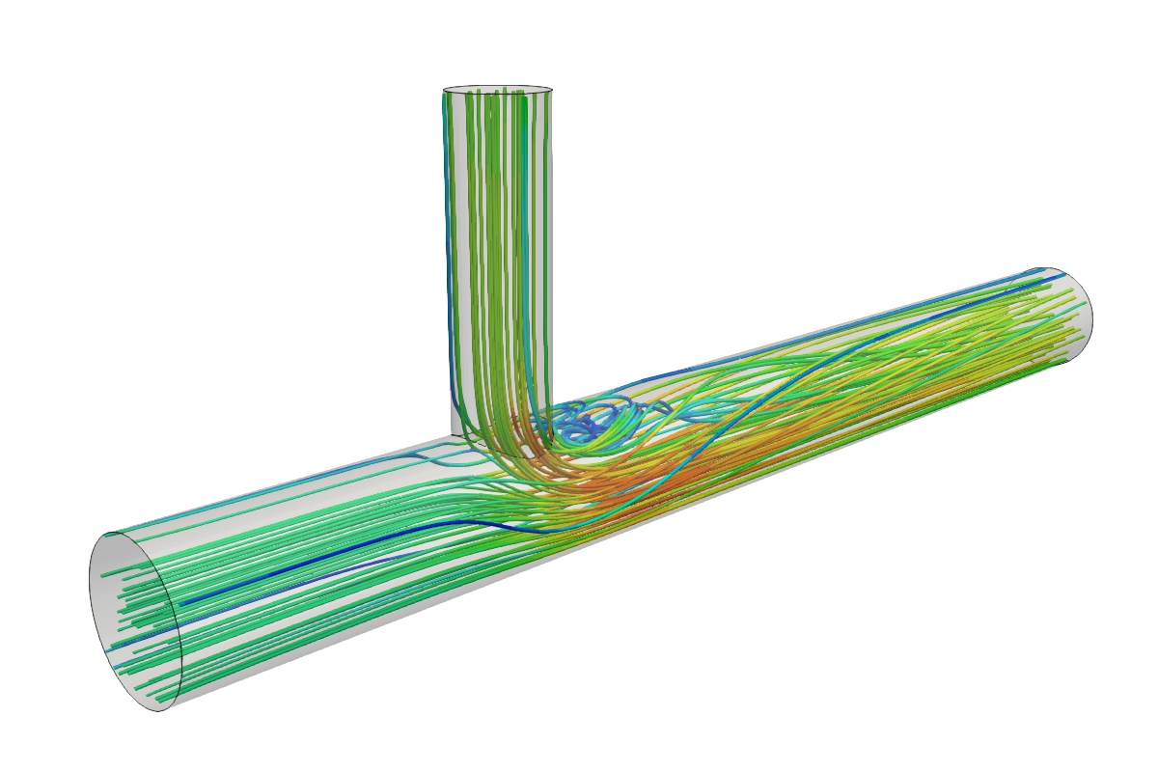
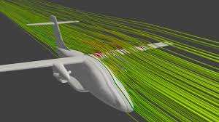
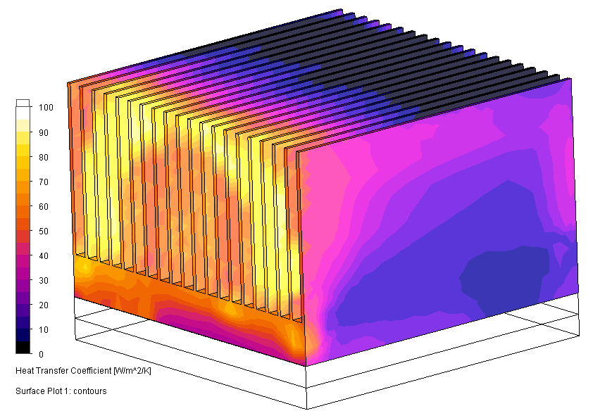
Flow around the aircraft
Internal pipe flow
Thermal analysis

Slide 4
Why CFD is important?
Saves time and cost compared to experiments.
Gives detailed flow visualization
Allows testing of multiple design options quickly.
Can predict performance even before making a prototype.
For example: If we think about designing a car, rather than building 10 prototypes and testing them in wind tunnels, we can simulate airflow digitally and know how to improve the design much faster.

Slide 5
Computational Transport Phenomena
CFD is basically a Computational Transport Phenomena.
Fluid flow, heat transfer and mass transfer are all transport phenomena.
They describe how momentum, energy and mass move through fluids.
CFD numerically solves the governing equations for these transport processes.
We can put it in simple words, transport phenomenon is all about how things move. Whether it can be movement of the fluid itself(momentum),temperature(energy),or species like oxygen or pollutants (mass).CFD helps us understand all three together

Slide 6
Governing Equations
Continuity Equation - Conservation of mass.
Momentum Equation - Newton’s 2nd Law applied to fluids (Navier-Stokes).
Energy Equation - Conservation of energy (heat transfer)
Species Transport Equation - Conservation of mass of chemical species.
All CFD is based on these fundamental equations: Mass, Momentum and energy conservation. But since solving them analytically is almost impossible for real world cases, we use numerical methods.

Slide 7
Applications of CFD
Aerospace
Automobile
Biomedical
Chemical
Materials processing
Microfluidics
Electronics
Turbo machines

Slide 8
How CFD Solves Transport Phenomena
Pre-processing
Solver
Post-processing
Create Geometry
Mesh the domain
Define boundary conditions
Apply governing equations
Use numerical methods like Finite Volume or Finite element.
Iteratively solve equations until convergence
Visualize results (pressure, Velocity, temperature contours)
Analyze and validate

Slide 9
Alternate Approaches to CFD
There are 2 other major ways to study transport phenomena:
1. Analytical Approach:
Uses mathematical equations and exact solutions.
Works for simple cases.(ex: laminar flow in pipe)
Limitation: Becomes very complex for real systems.
2. Experimental Approach:
Physical testing using equipment (wind tunnels, flow benches)
Real world validation
Limitation: Costly, time consuming and difficult to visualize internally.
So, CFD acts like a bridge, not as idealized as equations, not as expensive as experiments. It gives a realistic and detailed picture digitally.

